Slide 1
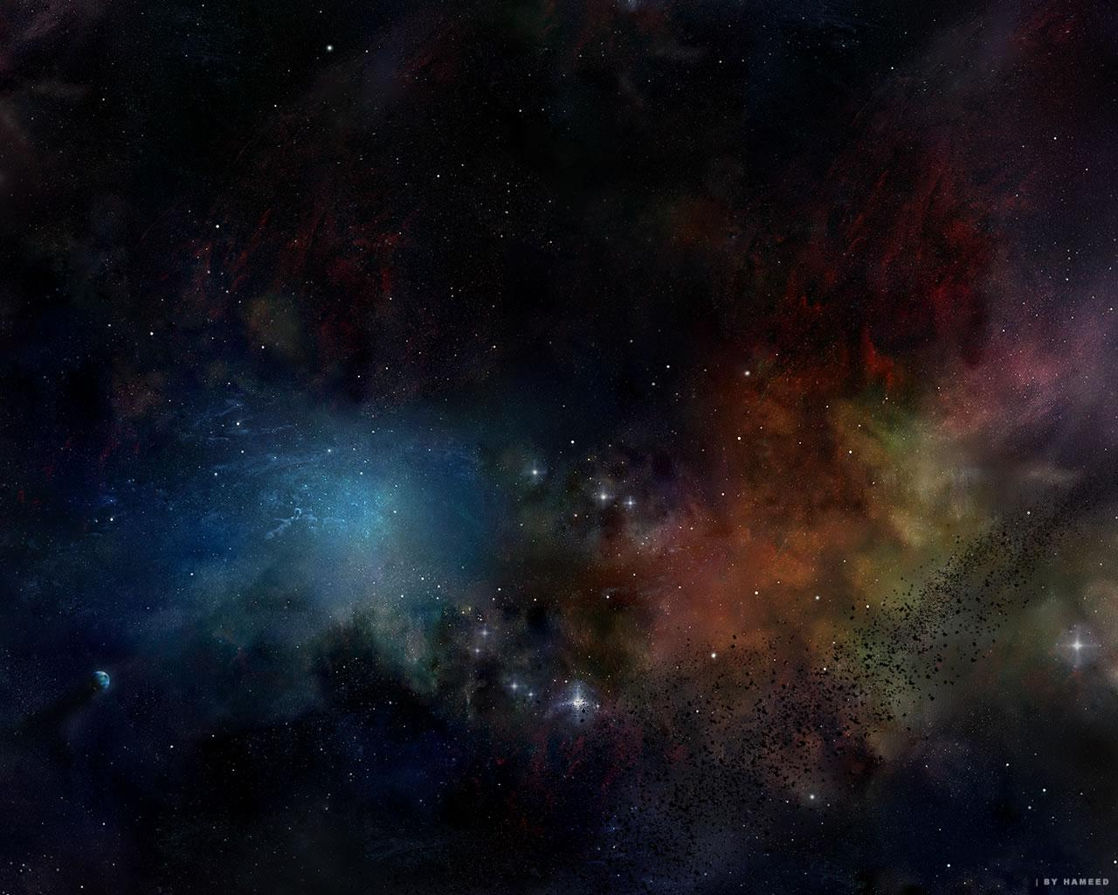
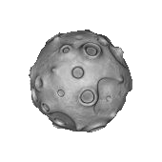

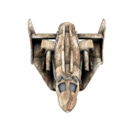
Home Page
Gameplay
Evolution
Team
Improvements
6 Guys, 1 Asteroid
Challenges
Software Architecture

Slide 2
Team
Team
Andrew Dennis
Jeffrey Leung
Corey Perlman
Richard Pringle
Neil Sabharwal
Hoai Phuoc Truong
6 Guys, 1 Asteroid

Slide 3
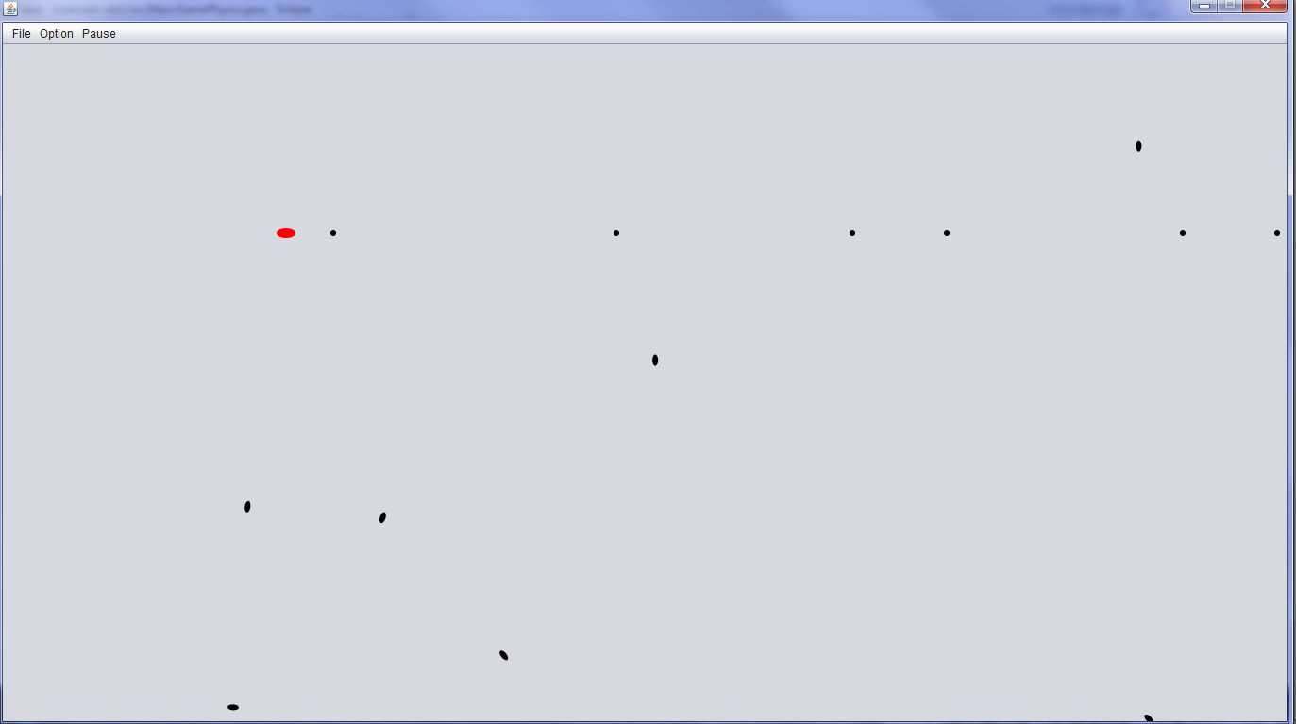
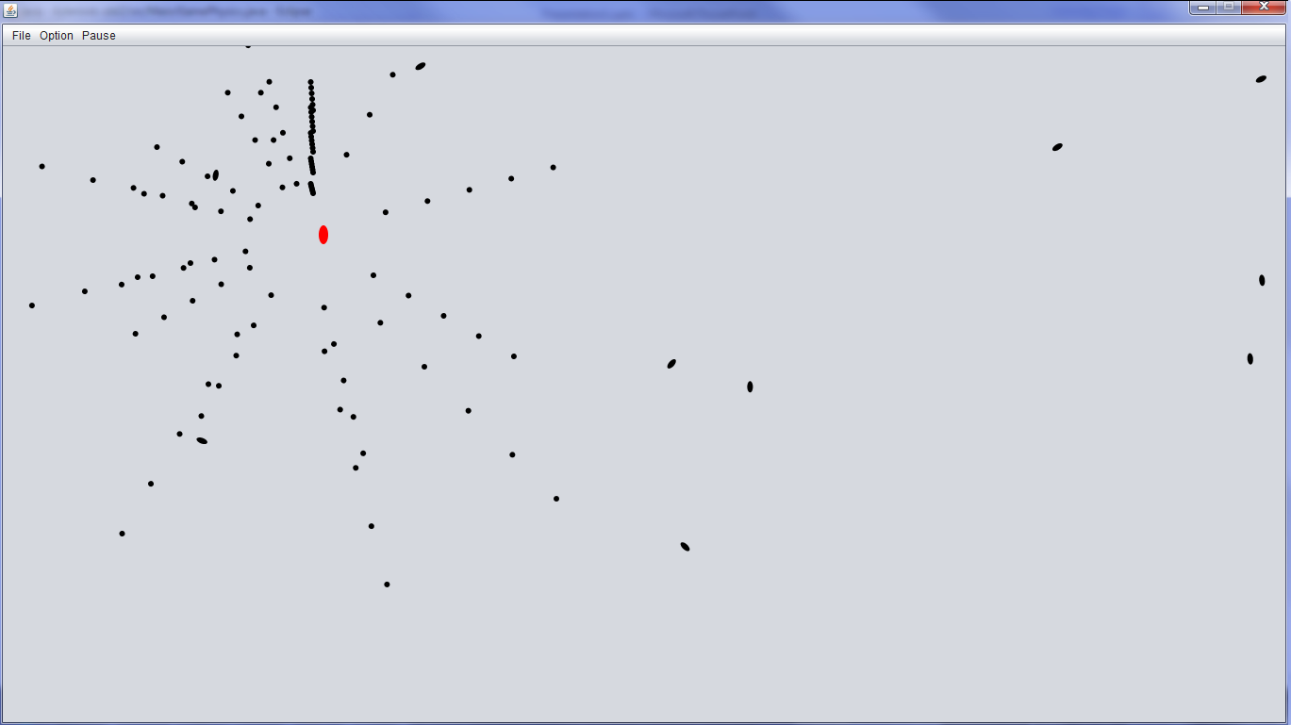
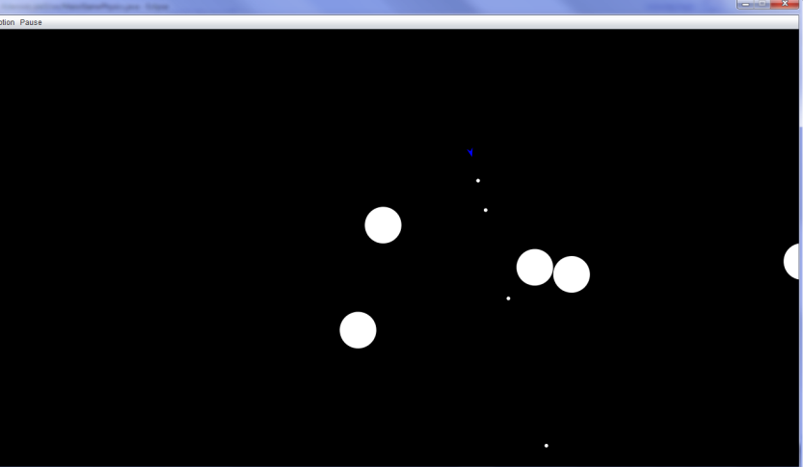
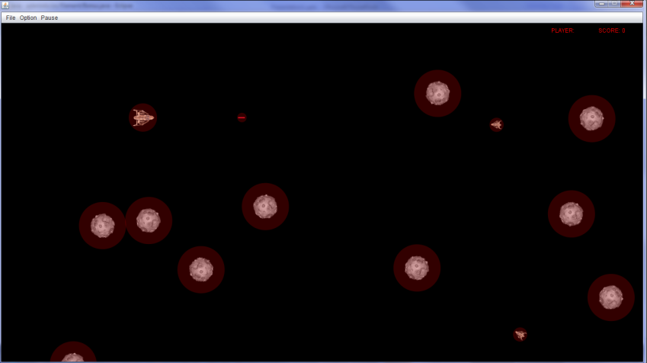
Evolution
Evolution
6 Guys, 1 Asteroid

Slide 4
Challenges
Challenges
- Physics
- Graphics
- The Integration of the two
General Debugging
6 Guys, 1 Asteroid
Notes:
First we struggled with the physics
Then the graphics
Integrating the two with collisions
Finding the source of error with 6 different people and a lot classes

Slide 5
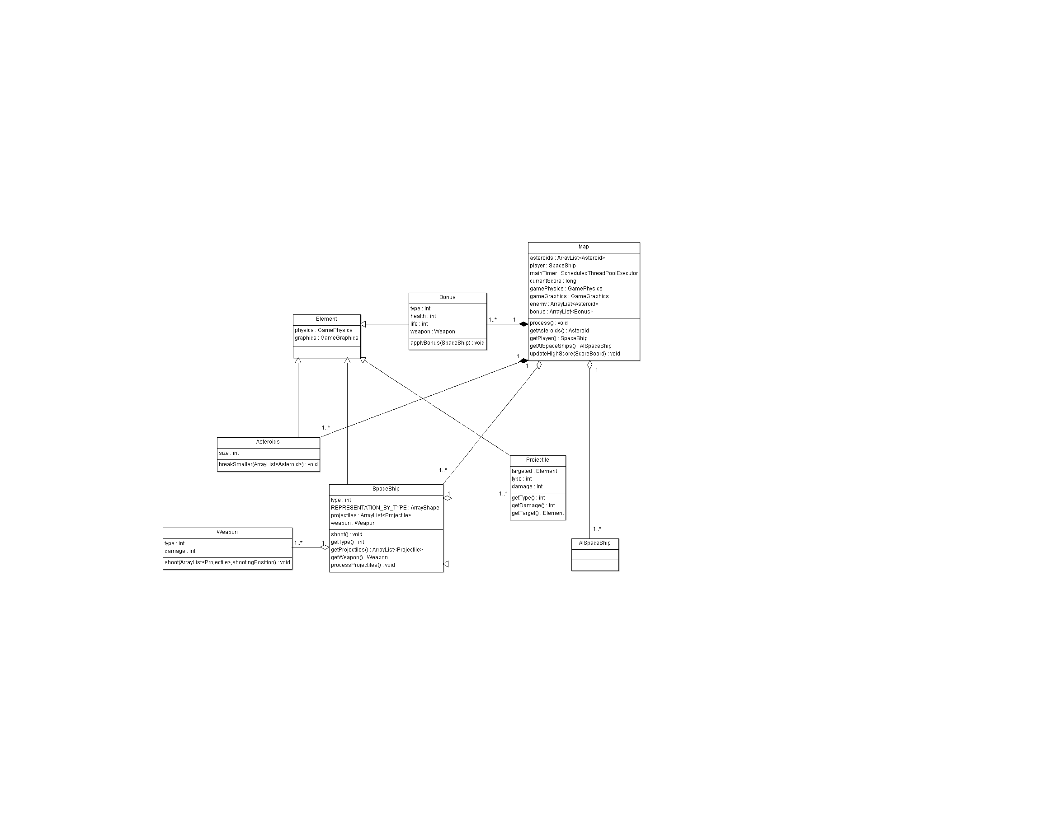

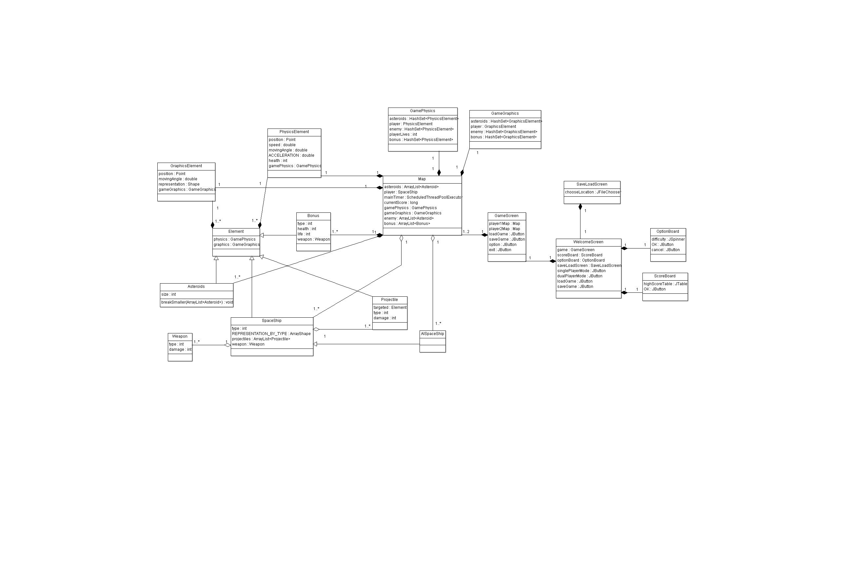
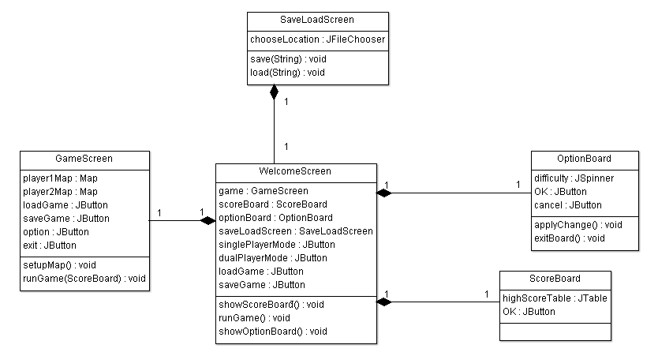
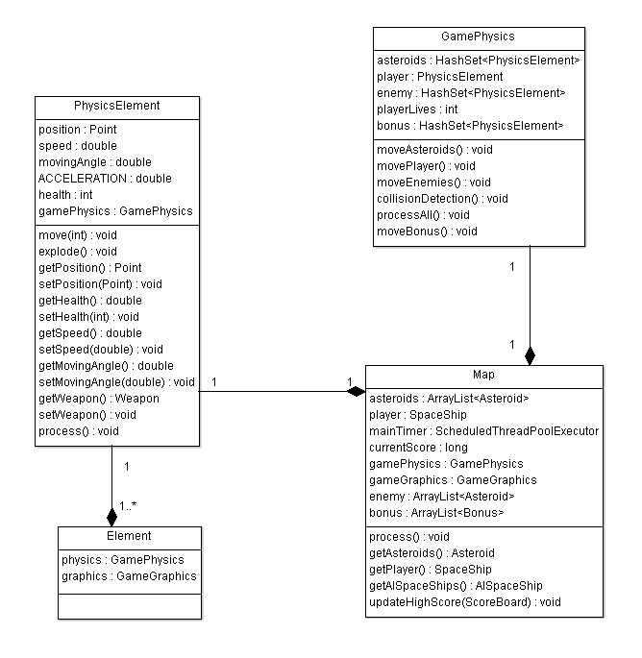
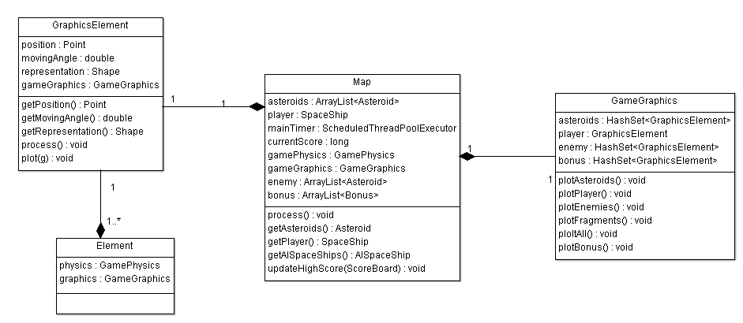
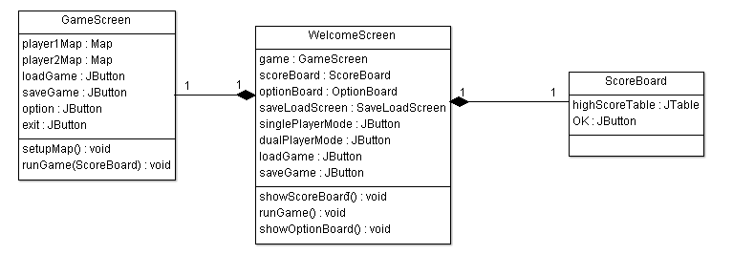
Software Architecture
Software Architecture
Overall Class Diagram
6 Guys, 1 Asteroid
Multiplayer Subsystem
Gamescore Subsystem
Graphics Subsystem
Element Subsystem
Physics Subsystem
UI Subsystem

Slide 6
Gameplay
Gameplay
Breakable Asteroids
Alien Ships
High Score List
Sounds
Multiplayer Mode ~ Alternating Turns
Different Difficulties
Weapon Upgrades
Save and Load Game
Lives for Players
6 Guys, 1 Asteroid
Notes:
Differences
-shoots 3 projectiles at the start instead of 1
-asteroid breaks up into 4
-backwards movement
-bullets disappear when they exit the game screen
-pause
-save/load
-difficulty settings
-multiplayer mode
-levels
-aliens show up every 3000pts

Slide 7
Improvements
Future Implementations
Bonus, weapons, health etc
Variable alien difficulties
Health bar
Limited ammo
Various asteroid speeds
Boss
2 Player Team up with Simultaneous play
Fire rate control
6 Guys, 1 Asteroid

Slide 8
Evolution
Simple shapes
No collision detection
Poor navigation ~ No deceleration
No environment wrap around
No sounds
No alien
6 Guys, 1 Asteroid
Notes:
Graphics2D class
- started with ovals
Bad movement with speed affecting rotation
- infinite speed
- No deceleration
No wrap around
Unlimited shooting

Slide 9
Evolution
Collision detection implemented but not accurate
Physics & navigation are accurate
Environment wraparound
6 Guys, 1 Asteroid
Notes:
Problems we ran into:
The acceleration was too fast – couldn’t control the ship well
Changed car like movement
Unlimited shooting
Spray shooting
We chose to not have bullets wrap around
No background image

Slide 10
Evolution
Collision detection improved
Projectiles
Shooting fixed
6 Guys, 1 Asteroid
Notes:
Problems:
Collision detection not always working – since the radius of different object did not implement properly must hit direct center of the object
The background still couldn’t be set, nor could the images
Asteroids didn’t split
Projectile trajectory wasn’t good

Slide 11
Evolution
Testing radius
Images added
Asteroids split
6 Guys, 1 Asteroid
Notes:
How we corrected some issues:
To improve the collision detection we added a faint outline to the asteroids
The outline allowed us to see where the collision radius was and then work from there
We figured out how to add images
We also had asteroids break up, but the physics values that were passed to them were not correct
The smaller asteroids would just sit still, or go in the wrong direction

